Slide 1
Lecture 5: Neural Networks

Slide 2
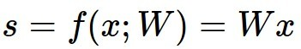
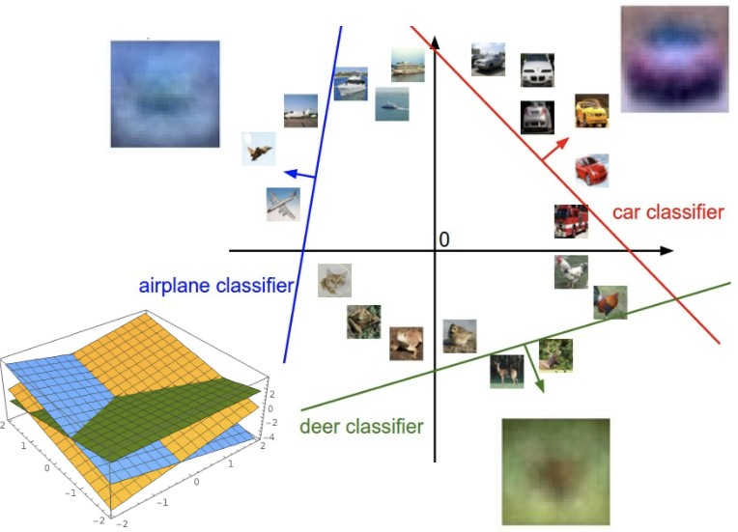
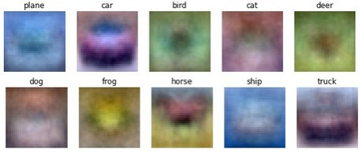
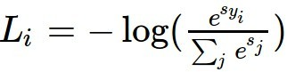
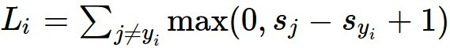
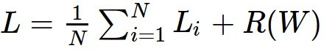
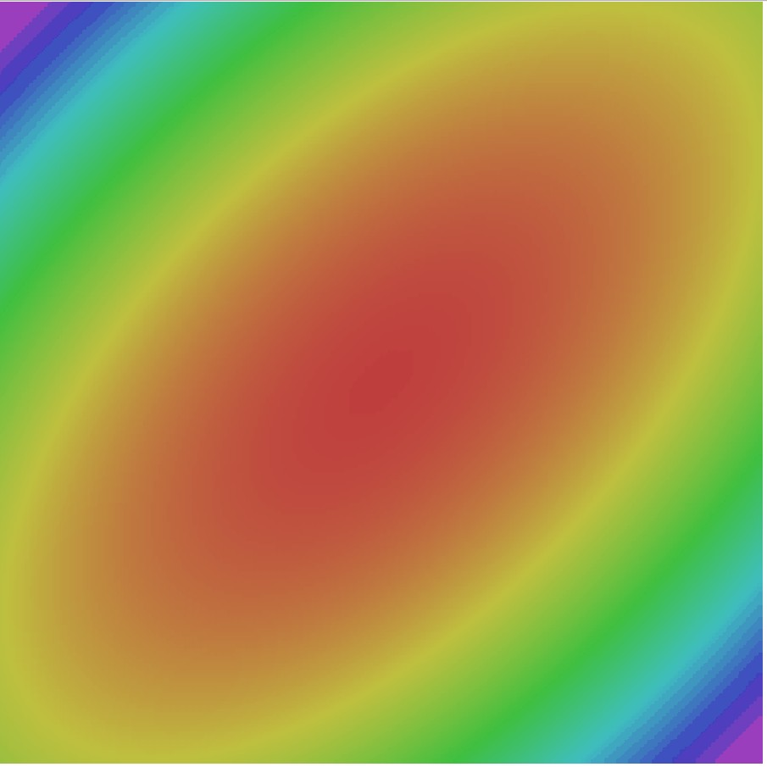
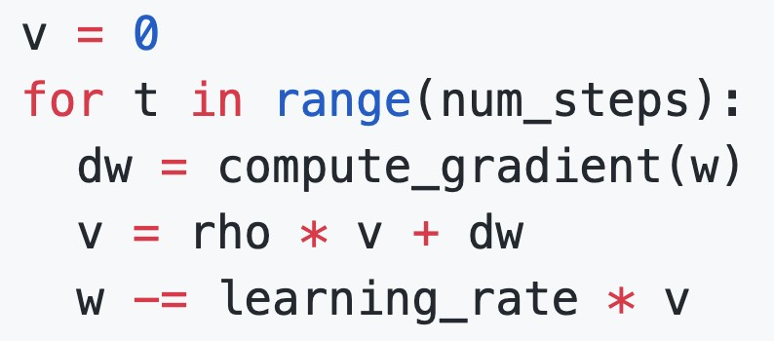
Where we are:
Use Linear Models for image classification problems
Use Loss Functions to express preferences over different choices of weights
Use Stochastic Gradient Descent to minimize our loss functions and train the model
Softmax
SVM

Slide 3
Problem: Linear Classifiers aren’t that powerful
Geometric Viewpoint
y
Visual Viewpoint
One template per class: Can’t recognize different modes of a class
x

Slide 4
One solution: Feature Transforms
Original space
y
r = (x² + y²)^{1/2} θ = tan⁻¹(y/x)
x
Feature transform

Slide 5
One solution: Feature Transforms
Original space
Feature space
y
θ
r = (x² + y²)^{1/2} θ = tan⁻¹(y/x)
x
r
Feature transform

Slide 6
One solution: Feature Transforms
Original space
Feature space
y
θ
r = (x² + y²)^{1/2} θ = tan⁻¹(y/x)
x
r
Feature transform
Linear classifier in feature space

Slide 7
One solution: Feature Transforms
Original space
Feature space
y
θ
r = (x² + y²)^{1/2} θ = tan⁻¹(y/x)
x
r
Feature transform
Nonlinear classifier in original space!
Linear classifier in feature space

Slide 8


Image Features: Color Histogram
Ignores texture, spatial positions
+1

Slide 9

Image Features: Histogram of Oriented Gradients (HoG)
Compute edge direction / strength at each pixel
Divide image into 8x8 regions
Within each region compute a
histogram of edge directions weighted by edge strength
Lowe, “Object recognition from local scale-invariant features”, ICCV 1999
Dalal and Triggs, "Histograms of oriented gradients for human detection," CVPR 2005

Slide 10
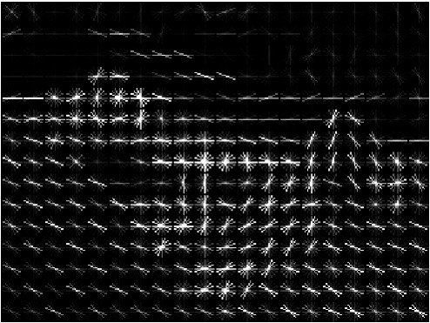
Image Features: Histogram of Oriented Gradients (HoG)
1. Compute edge direction / strength at each pixel
Example: 320x240 image gets divided into 40x30 bins; 8
2. Divide image into 8x8 regions
3. Within each region compute a
histogram of edge directions weighted by edge strength
directions per bin; feature vector has 30*40*9 = 10,800 numbers
Lowe, “Object recognition from local scale-invariant features”, ICCV 1999
Dalal and Triggs, "Histograms of oriented gradients for human detection," CVPR 2005

Slide 11
Image Features: Histogram of Oriented Gradients (HoG)
Weak edges
Strong diagonal edges
Edges in all directions
1. Compute edge direction / strength at each pixel
Example: 320x240 image gets divided into 40x30 bins; 8
2. Divide image into 8x8 regions
3. Within each region compute a
histogram of edge directions weighted by edge strength
directions per bin; feature vector has 30*40*9 = 10,800 numbers
Lowe, “Object recognition from local scale-invariant features”, ICCV 1999
Dalal and Triggs, "Histograms of oriented gradients for human detection," CVPR 2005

Slide 12
Image Features: Histogram of Oriented Gradients (HoG)
Weak edges
Strong diagonal edges
Edges in all directions
Captures texture and position,
1. Compute edge direction / strength at each pixel
Example: 320x240 image gets divided into 40x30 bins; 8
2. Divide image into 8x8 regions
3. Within each region compute a
histogram of edge directions weighted by edge strength
robust to small image changes
directions per bin; feature vector has 30*40*9 = 10,800 numbers
Lowe, “Object recognition from local scale-invariant features”, ICCV 1999
Dalal and Triggs, "Histograms of oriented gradients for human detection," CVPR 2005

Slide 13


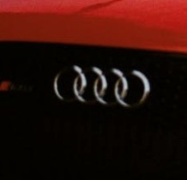







Image Features: Bag of Words (Data-Driven!)
Step 1: Build codebook
Cluster patches to form “codebook” of “visual words”
Extract random patches

Slide 14




Image Features: Bag of Words (Data-Driven!)
Step 1: Build codebook
Cluster patches to form “codebook” of “visual words”
Extract random patches
Step 2: Encode images

Slide 15
Image Features

Slide 16
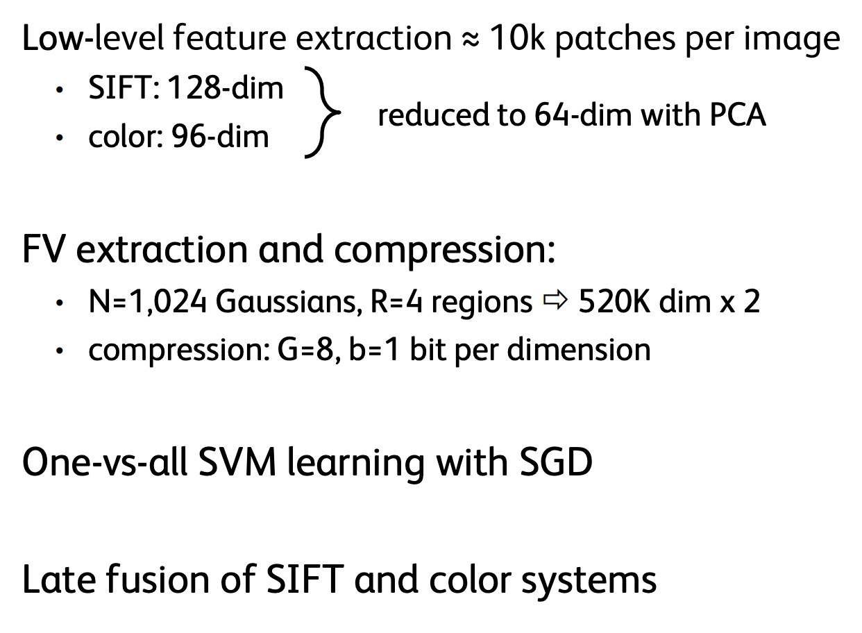
Example: Winner of 2011 ImageNet challenge
F. Perronnin, J. Sánchez, “Compressed Fisher vectors for LSVRC”, PASCAL VOC / ImageNet workshop, ICCV, 2011.

Slide 17
Image Features
f
Feature Extraction
10 numbers giving scores for classes
training

Slide 18

Image Features vs Neural Networks
f
Feature Extraction
10 numbers giving scores for classes
training
Krizhevsky, Sutskever, and Hinton, “Imagenet classification with deep convolutional neural networks”, NIPS 2012.
Figure copyright Krizhevsky, Sutskever, and Hinton, 2012. Reproduced with permission.
10 numbers giving scores for classes
training

Slide 19
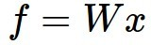
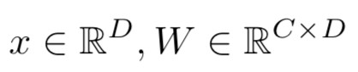
Neural Networks
(Before) Linear score function:

Slide 20
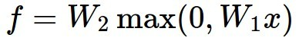
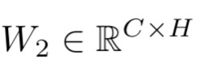
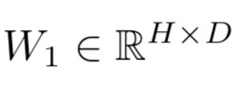
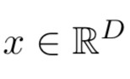
Neural Networks
(Before) Linear score function: (Now) 2-layer Neural Network
(In practice we will usually add a learnable bias at each layer as well)

Slide 21
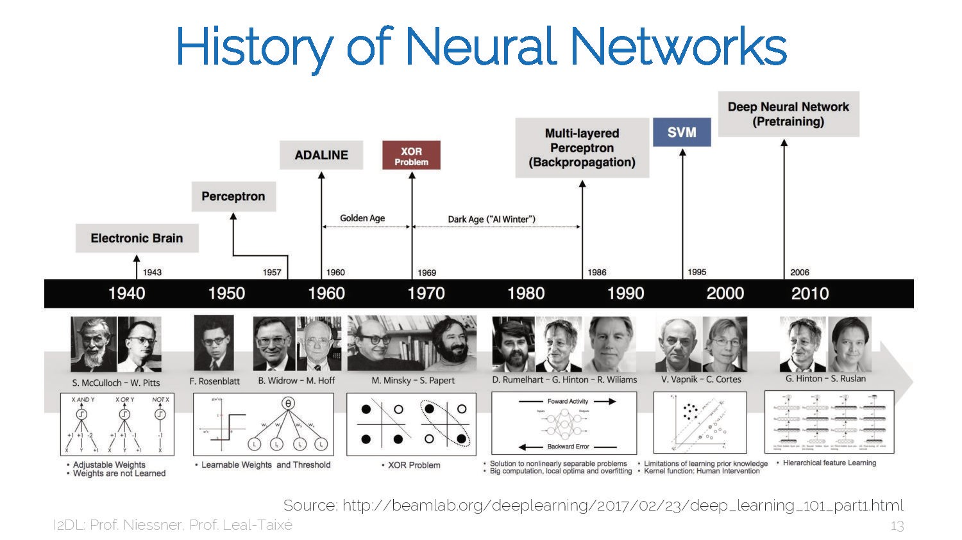
21

Slide 22
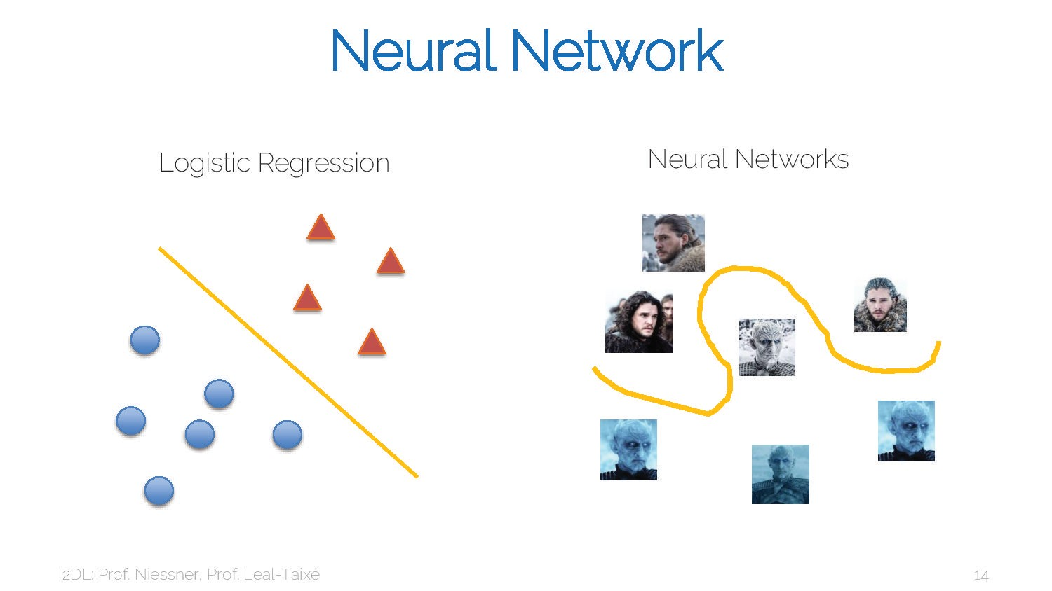
22

Slide 23
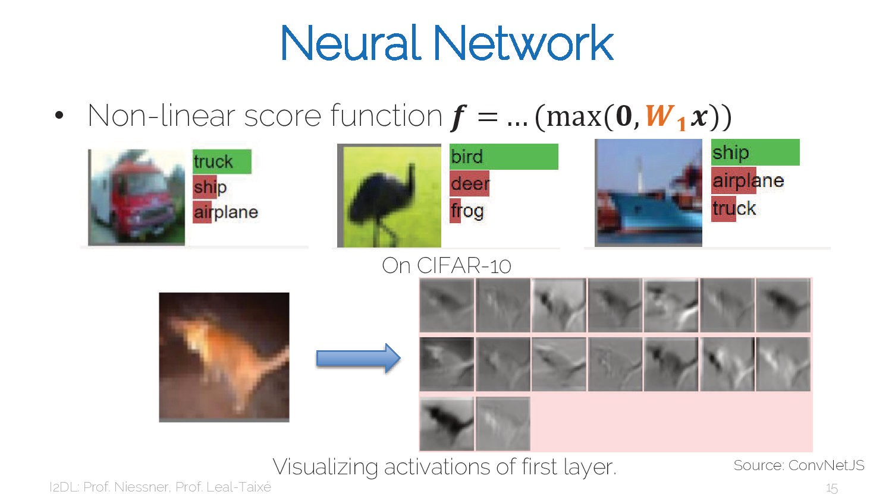
23

Slide 24
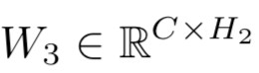
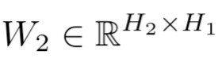
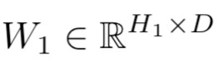
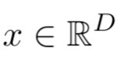
Neural Networks
(Before) Linear score function: (Now) 2-layer Neural Network
or 3-layer Neural Network
(In practice we will usually add a learnable bias at each layer as well)

Slide 25
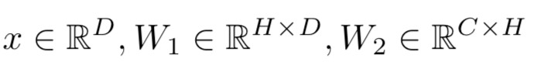
Neural Networks
(Before) Linear score function: (Now) 2-layer Neural Network
x
h
Input: 3072
W₁
s
W₂
Output: 10
Hidden layer: 100

Slide 26
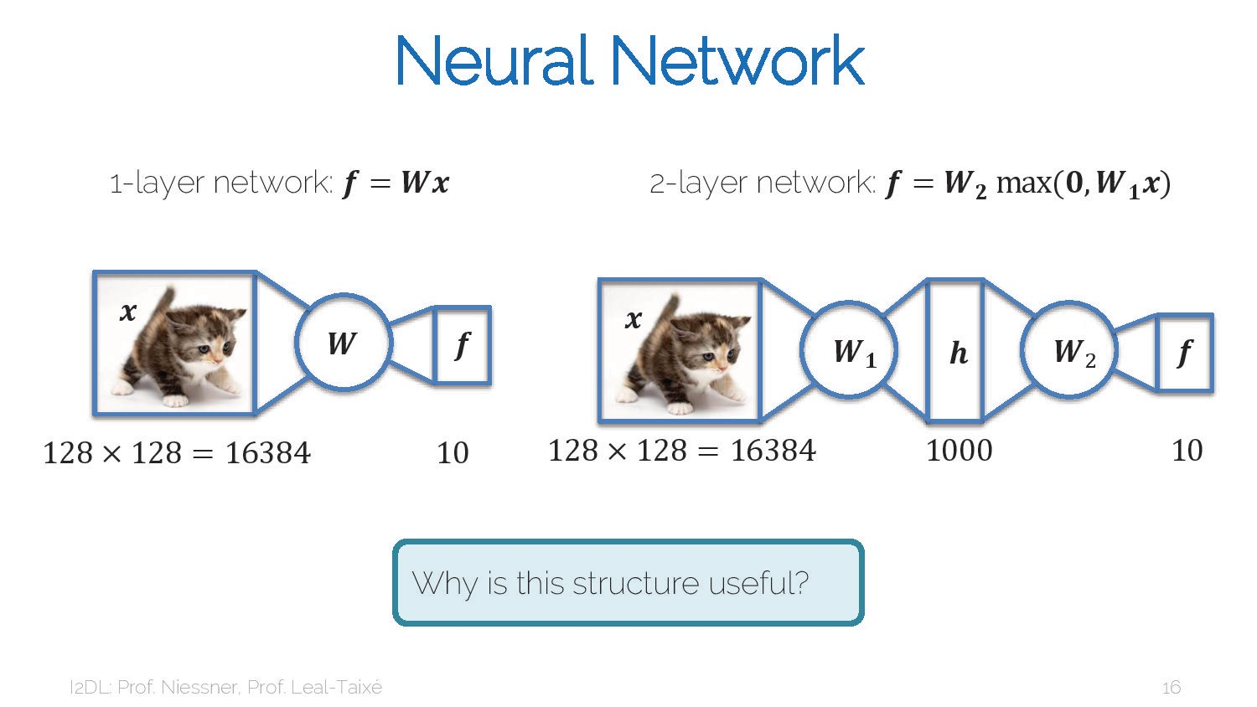
26

Slide 27
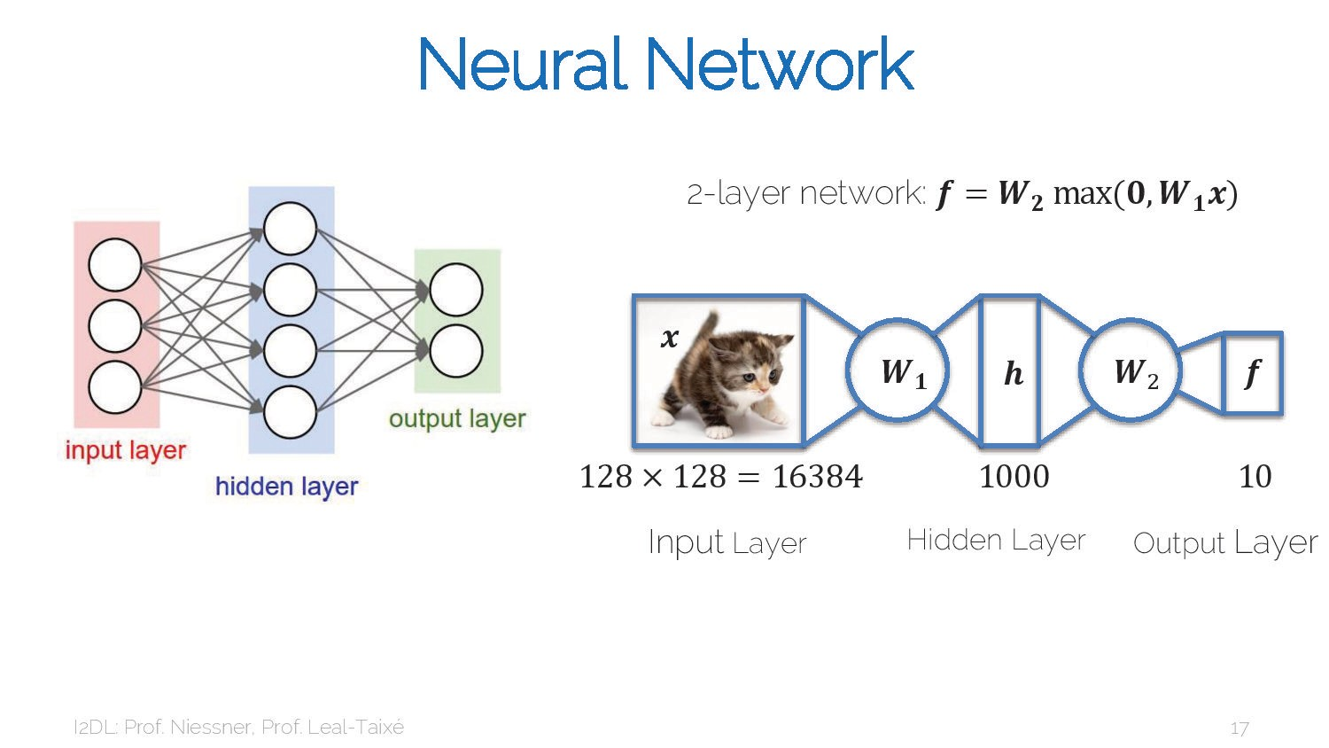
27

Slide 28
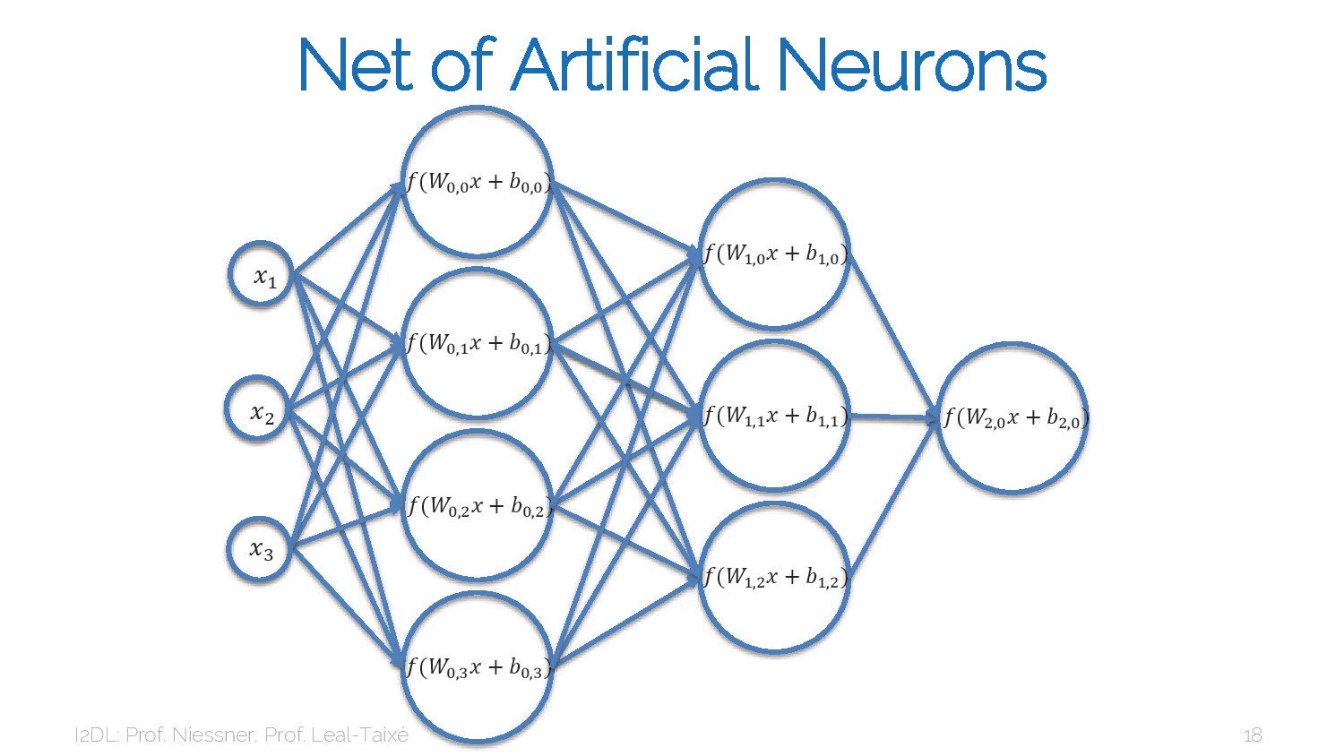
28

Slide 29
Neural Networks
(Before) Linear score function: (Now) 2-layer Neural Network
Element (i, j) of W₁ gives the effect on h_{i} from x_{j}
Element (i, j) of W₂ gives the effect on s_{i} from h_{j}
Input: 3072
x
W
h
W
s
1
2
Output: 10
Hidden layer: 100

Slide 30
Neural Networks
(Before) Linear score function: (Now) 2-layer Neural Network
Element (i, j) of W₁ gives the effect on h_{i} from x_{j}
Element (i, j) of W₂ gives the effect on s_{i} from h_{j}
All elements of h affect all elements of s
Input: 3072
x
W₁
h
W₂
s
All elements of x affect all elements of h
Output: 10
Hidden layer: 100
Fully-connected neural network Also “Multi-Layer Perceptron” (MLP)

Slide 31
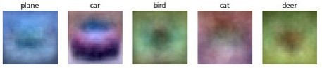
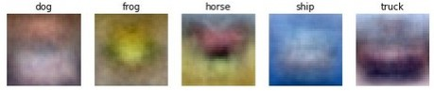
Neural Networks
(Before) Linear score function:
(Now) 2-layer Neural Network
Linear classifier: One template per class
x
h
Input: 3072
W₁
s
W₂
Output: 10
Hidden layer: 100

Slide 32
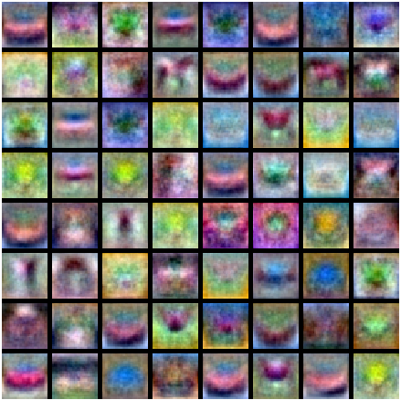
Neural Networks
Neural net: first layer is bank of templates; Second layer recombines templates
(Before) Linear score function: (Now) 2-layer Neural Network
x
h
Input: 3072
W₁
s
W₂
Output: 10
Hidden layer: 100

Slide 33
Neural Networks
Can use different templates to cover multiple modes of a class!
(Before) Linear score function: (Now) 2-layer Neural Network
x
h
Input: 3072
W₁
s
W₂
Output: 10
Hidden layer: 100

Slide 34
Neural Networks
“Distributed representation”: Most templates not interpretable!
(Before) Linear score function: (Now) 2-layer Neural Network
x
h
Input: 3072
W₁
s
W₂
Output: 10
Hidden layer: 100

Slide 35
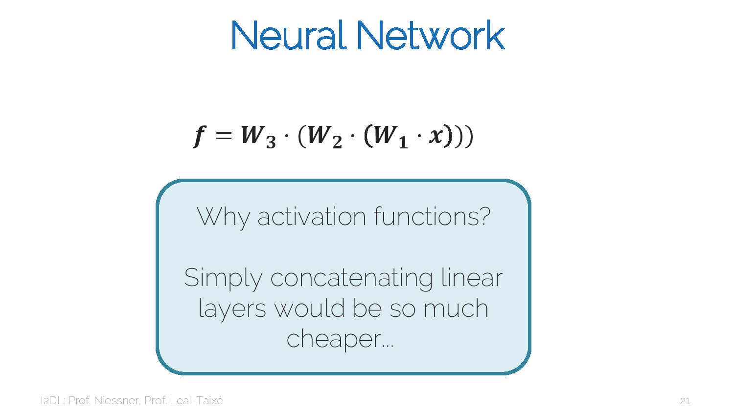
35

Slide 36
Deep Neural Networks
Depth = number of layers
h₁ | W₂ | h₂ | W₃ | h₃ | W₄ | h₄ | W₅ | h₅
x
Width: Size of each layer
s
W₁
W₆
Output: 10
Input: 3072

Slide 37
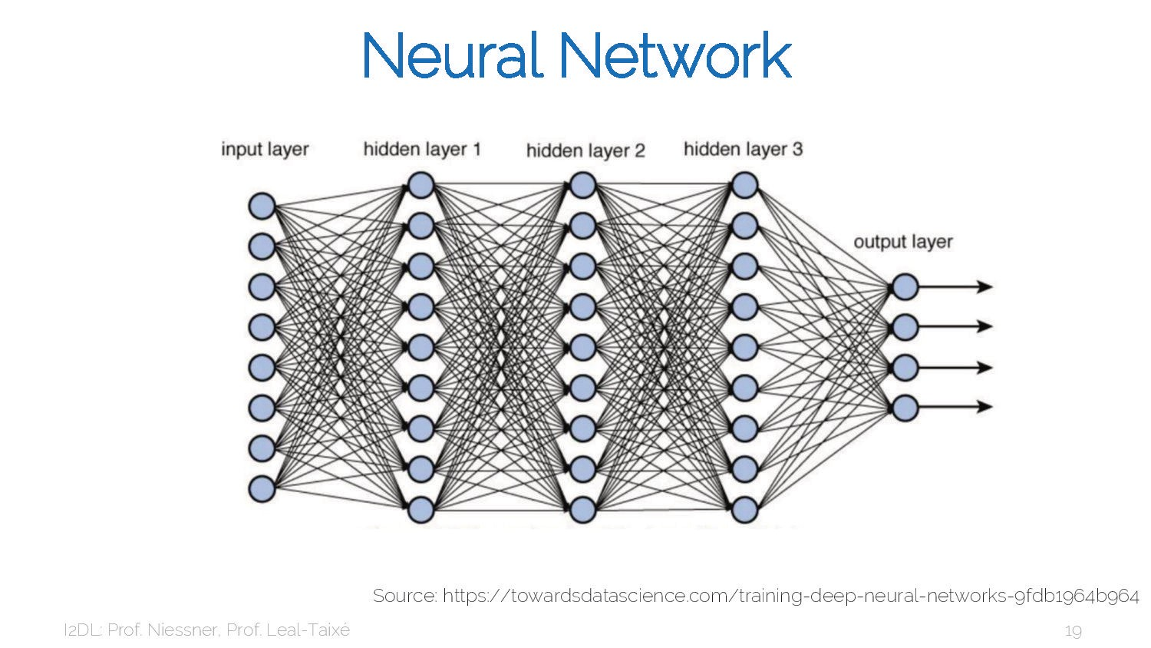
37

Slide 38
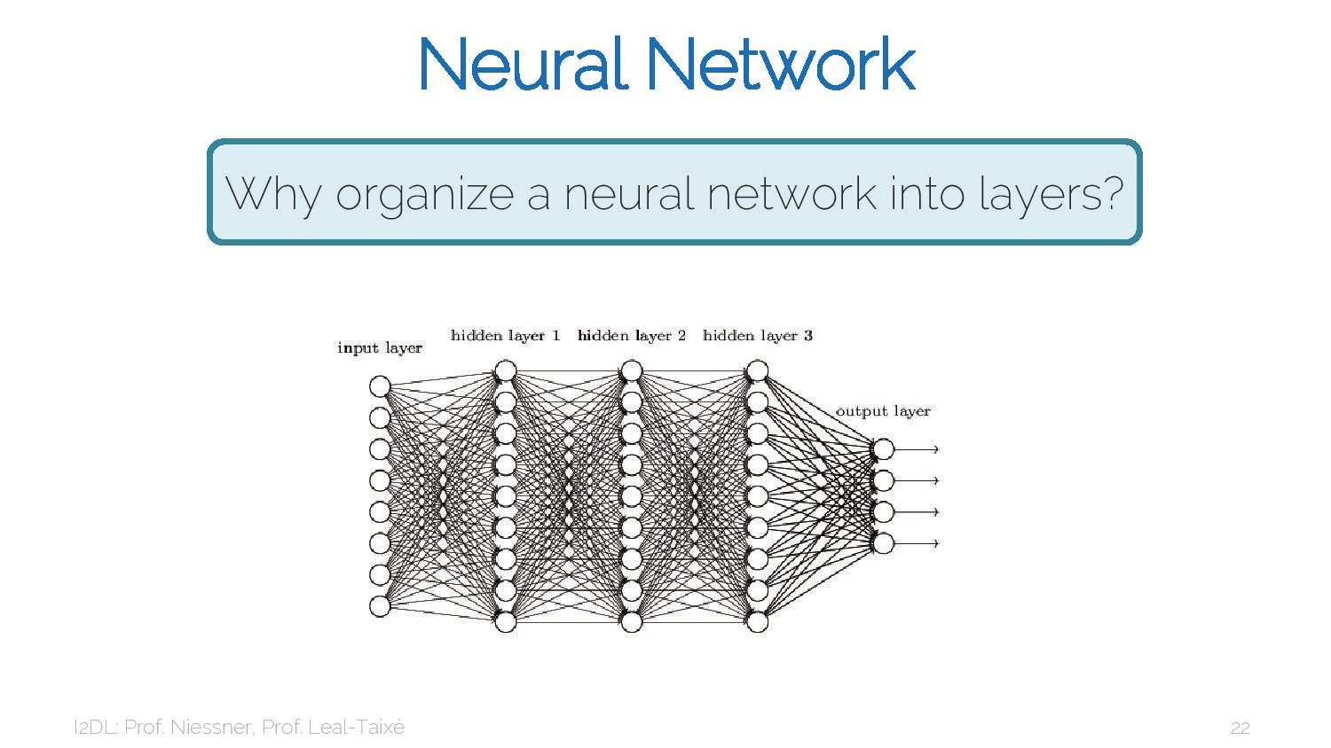
38

Slide 39

39

Slide 40
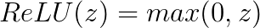
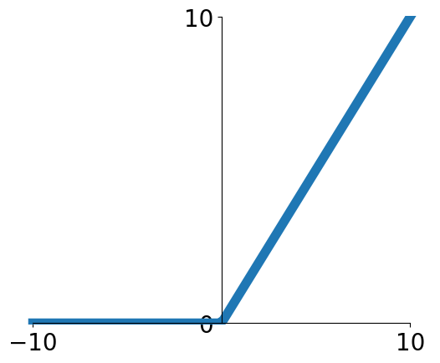
Activation Functions
2-layer Neural Network
The function
is called “Rectified Linear Unit”
This is called the activation function of the neural network

Slide 41
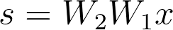
Activation Functions
2-layer Neural Network
The function
is called “Rectified Linear Unit”
This is called the activation function of the neural network
Q: What happens if we build a neural network with no activation function?

Slide 42
Activation Functions
2-layer Neural Network
The function
is called “Rectified Linear Unit”
This is called the activation function of the neural network
Q: What happens if we build a neural network with no activation function?
A: We end up with a linear classifier!

Slide 43
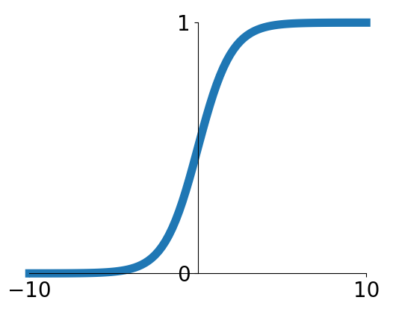
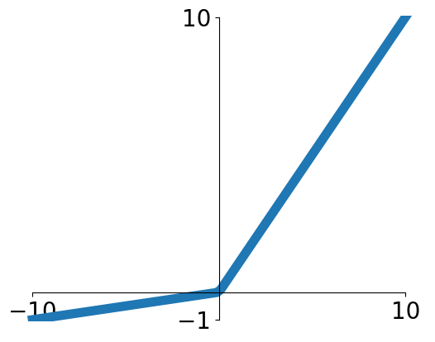
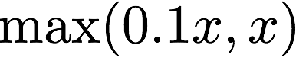
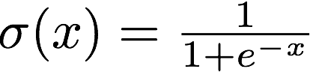
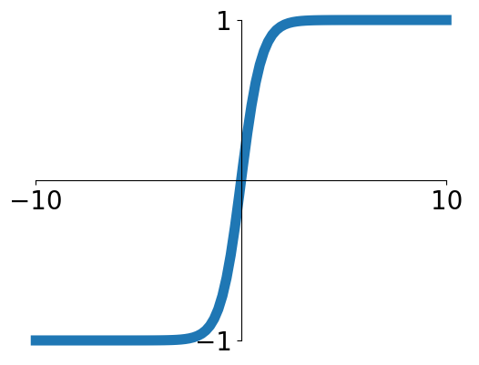
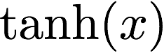
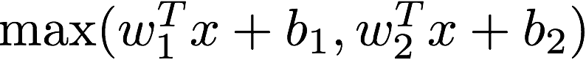
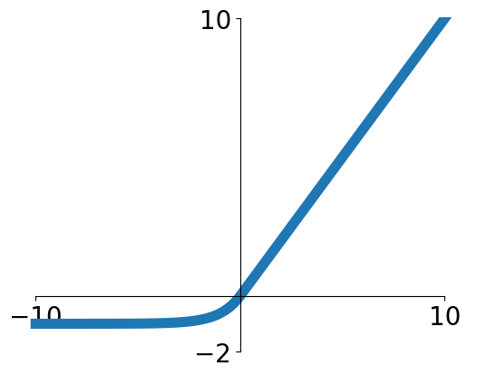
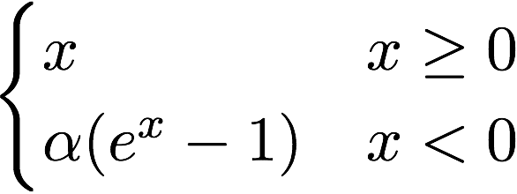
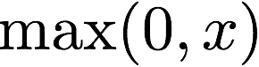
Activation Functions
Sigmoid
Leaky ReLU
tanh
Maxout
ReLU
ELU

Slide 44
Activation Functions
ReLU is a good default choice for most problems
Leaky ReLU
Sigmoid
tanh
Maxout
ReLU
ELU

Slide 45
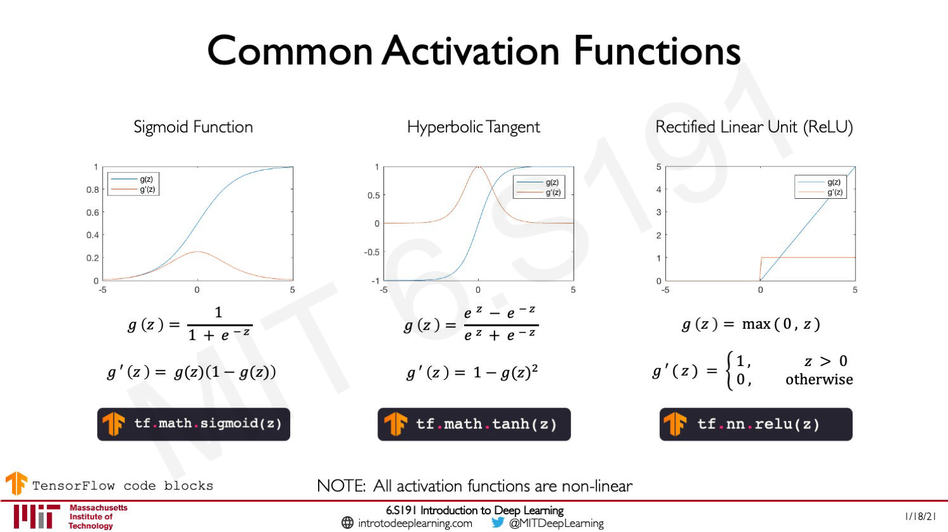
45

Slide 46
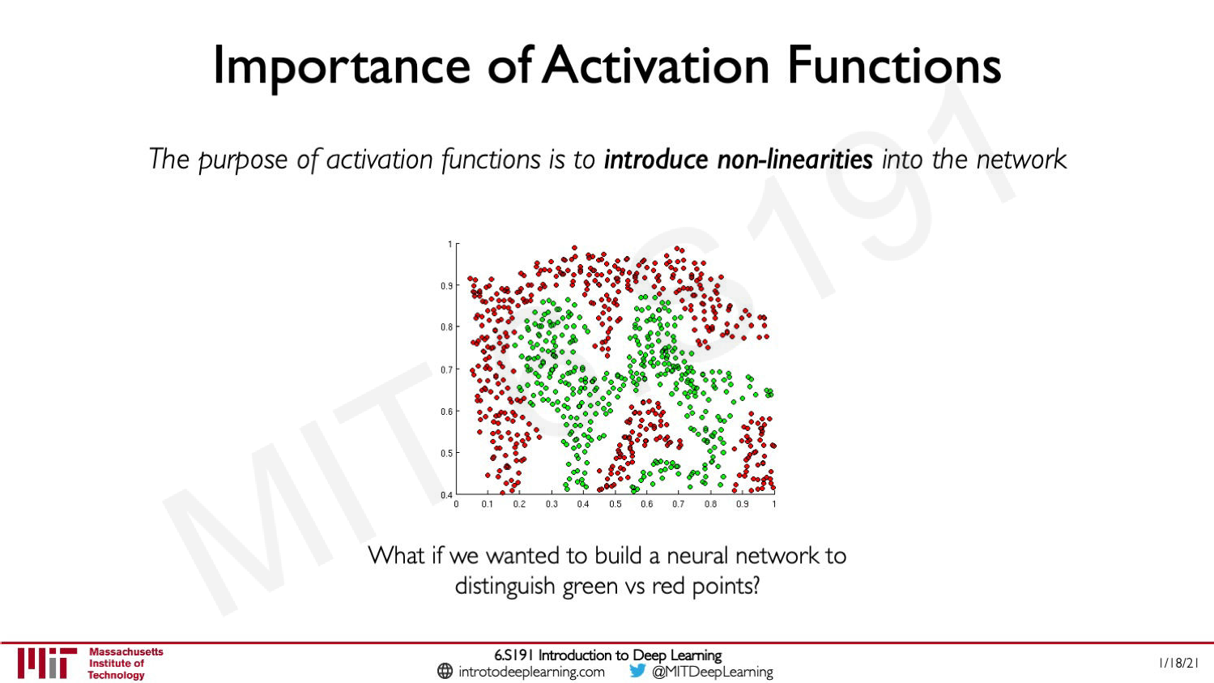
46

Slide 47
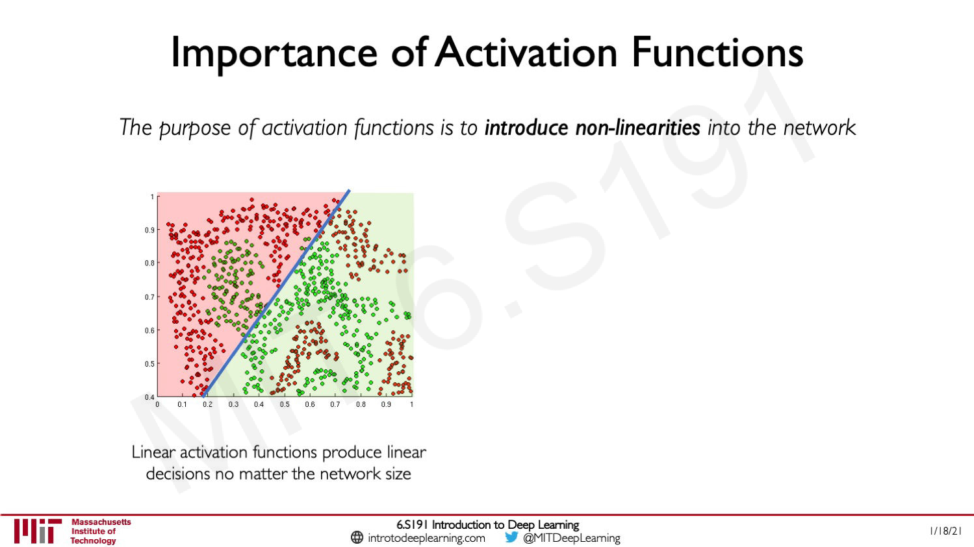
47

Slide 48

48

Slide 49

49

Slide 50

50

Slide 51

51

Slide 52

52

Slide 53

53

Slide 54

54

Slide 55

55

Slide 56

56

Slide 57

57

Slide 58

58

Slide 59

59

Slide 60

60

Slide 61

61

Slide 62

62

Slide 63

63

Slide 64

64

Slide 65

65

Slide 66

66

Slide 67

67

Slide 68

68

Slide 69

69

Slide 70

70

Slide 71

71

Slide 72

72

Slide 73

73

Slide 74

74

Slide 75

75

Slide 76

76

Slide 77

77

Slide 78

78

Slide 79

79

Slide 80

80

Slide 81

81

Slide 82

82

Slide 83

83

Slide 84

84

Slide 85

85

Slide 86

86

Slide 87

87

Slide 88

88

Slide 89

89

Slide 90

90

Slide 91

91

Slide 92

92

Slide 93

93

Slide 94

94

Slide 95

95

Slide 96

96

Slide 97

97

Slide 98

98

Slide 99

99

Slide 100

100

Slide 101

101

Slide 102

102

Slide 103

103

Slide 104

104

Slide 105

105

Slide 106

106

Slide 107

107

Slide 108

108

Slide 109

109

Slide 110

110

Slide 111

111

Slide 112

112

Slide 113


Neural Net in <20 lines!

Slide 114
Neural Net in <20 lines!
Initialize weights and data

Slide 115
Neural Net in <20 lines!
Initialize weights and data
Compute loss (sigmoid activation, L2 loss)

Slide 116
Neural Net in <20 lines!
Initialize weights and data
Compute loss (sigmoid activation, L2 loss)
Compute gradients

Slide 117
Neural Net in <20 lines!
Initialize weights and data
Compute loss (sigmoid activation, L2 loss)
Compute gradients
SGD
step

Slide 118


Slide 119

Our brains are made of Neurons
Presynaptic terminal
Axon
Cell body
Dendrite

Slide 120














Our brains are made of Neurons
Presynaptic terminal
Axon
Synapse
Cell body
Dendrite

Slide 121




Our brains are made of Neurons
Presynaptic terminal
Axon
Synapse
Impulses carried away from cell body
Cell body
Impulses carried toward
cell body
Justin Johnson
Dendrite
Lecture 5 - 46
121

Slide 122

Our brains are made of Neurons
Presynaptic terminal
Axon
Synapse
Impulses carried away from cell body
Firing rate is a nonlinear function
Cell body
Impulses carried toward
Dendrite
of inputs
cell body
Justin Johnson
Lecture 5 - 47
122

Slide 123


Biological Neuron
dendrite
presynaptic terminal
Artificial Neuron
axon
cell body
Neuron image by Felipe Perucho is licensed under CC-BY 3.0
123

Slide 124

Biological Neurons: Complex connectivity patterns
Neurons in a neural network: Organized into regular layers for computational efficiency
This image is CC0 Public Domain
124

Slide 125

Biological Neurons: Complex connectivity patterns
But neural networks with random connections can work too!
This image is CC0 Public Domain
Xie et al, “Exploring Randomly Wired Neural Networks for Image Recognition”, ICCV 2019
Lecture 5 - 50
125

Slide 126

126

Slide 127

127

Slide 128

128

Slide 129
Be very careful with brain analogies!
Biological Neurons:
Many different types
Dendrites can perform complex non-linear computations
Synapses are not a single weight but a complex non- linear dynamical system
Rate code may not be adequate
[Dendritic Computation. London and Hausser]
129

Slide 130

130

Slide 131
131

Slide 132
Consider a linear transform: h = Wx Where x, h are both 2-dimensional
x2
x1
132

Slide 133
Space Warping
Consider a linear transform: h = Wx Where x, h are both 2-dimensional
x2
h2
Feature transform: h = Wx
x1
h1
133

Slide 134
Space Warping
Consider a linear transform: h = Wx Where x, h are both 2-dimensional
x2
h2
A
B
Feature transform: h = Wx
A
B
D
x1
h1
C
C
D
134

Slide 135
Consider a linear transform: h = Wx Where x, h are both 2-dimensional
Points not linearly separable in original space
x2
x1
135

Slide 136
Space Warping
Consider a linear transform: h = Wx Where x, h are both 2-dimensional
Not linearly separable
Points not linearly separable in original space
x2
in feature space
h2
Feature transform: h = Wx
x1
h1
136

Slide 137
Space Warping
Consider a neural net hidden layer: h = ReLU(Wx) = max(0, Wx) Where x, h are both 2-dimensional
x2
h2
Feature transform: h = ReLU(Wx)
x1
h1
137

Slide 138
Space Warping
Consider a neural net hidden layer: h = ReLU(Wx) = max(0, Wx) Where x, h are both 2-dimensional
x2
h2
A
Feature transform: h = ReLU(Wx)
A
x1
h1
138

Slide 139
Space Warping
Consider a neural net hidden layer: h = ReLU(Wx) = max(0, Wx) Where x, h are both 2-dimensional
x2
h2
A
Feature transform:
B
B
A
h = ReLU(Wx)
B is “collapsed” onto +h2 axis
x1
h1
139

Slide 140
Space Warping
Consider a neural net hidden layer: h = ReLU(Wx) = max(0, Wx) Where x, h are both 2-dimensional
x2
h2
A
Feature transform:
B
B
A
h = ReLU(Wx)
D
B is “collapsed” onto +h2 axis
x1
h1
D
D “collapsed” onto +h1 axis
Lecture 5 - 60
140

Slide 141
Space Warping
Consider a neural net hidden layer: h = ReLU(Wx) = max(0, Wx) Where x, h are both 2-dimensional
x2
h2
A
Feature transform:
B
B
A
h = ReLU(Wx)
D
B is “collapsed” onto +h2 axis
x1
h1
C
C
D
C “collapsed” onto origin
D “collapsed” onto +h1 axis
141

Slide 142
Space Warping
Points not linearly separable in original space
x2
Consider a neural net hidden layer: h = ReLU(Wx) = max(0, Wx) Where x, h are both 2-dimensional
h2
Feature transform: h = Wx
x1
h1
142

Slide 143

Space Warping
Points not linearly separable in original space
x2
Consider a neural net hidden layer: h = ReLU(Wx) = max(0, Wx) Where x, h are both 2-dimensional
h2
Feature transform: h = ReLU(Wx)
x1
h1
143

Slide 144
Space Warping
Points not linearly separable in original space
x2
Consider a neural net hidden layer: h = ReLU(Wx) = max(0, Wx) Where x, h are both 2-dimensional
h2
Feature transform: h = ReLU(Wx)
x1
h1
Points are linearly separable in features space!
144

Slide 145

Space Warping
Points not linearly separable in original space
x2
Consider a neural net hidden layer: h = ReLU(Wx) = max(0, Wx) Where x, h are both 2-dimensional
h2
Feature transform: h = ReLU(Wx)
x1
h1
Points are linearly separable in features space!
Linear classifier in feature space gives nonlinear classifier in original space
145

Slide 146

Setting the number of layers and their sizes
3 hidden units 6 hidden units 20 hidden units
More hidden units = more capacity
146

Slide 147

Don’t regularize with size; instead use stronger L2
(Web demo with ConvNetJS: http://cs.stanford.edu/people/karpathy/convnetjs/demo/classify2d.html)
147

Slide 148
Universal Approximation
A neural network with one hidden layer can approximate any function f: R^{N} -> R^{M} with arbitrary precision*
*Many technical conditions: Only holds on compact subsets of R^{N}; function must be continuous; need to define “arbitrary precision”; etc
148

Slide 149
Universal Approximation
Example: Approximating a function f: R -> R with a two-layer ReLU network
h₁ h₂
w₁
u₁
w₂ w₃
u₂ u₃
Input: x (1,)
x
y
Output: y (1,)
h₃
First layer weights: w (3,1) First layer bias: b (3,)
Second layer weights: u (1,3) First layer bias: p (1,)
149

Slide 150
Universal Approximation
Example: Approximating a function f: R -> R with a two-layer ReLU network
h₁ h₂
w₁
u₁
w₂ w₃
u₂ u₃
Input: x (1,)
x
y
Output: y (1,)
h₃
First layer weights: w (3,1) First layer bias: b (3,)
Second layer weights: u (1,3) First layer bias: p (1,)
h1 = max(0, w1 * x + b1) h2 = max(0, w2 * x + b2) h3 = max(0, w3 * x + b3)
y = u1 * h1 + u2 * h2 + u3 * h3 + p
Lecture 5 - 70
150

Slide 151
Universal Approximation
Example: Approximating a function f: R -> R with a two-layer ReLU network
h₁ h₂
w₁
u₁
w₂ w₃
u₂ u₃
Input: x (1,)
x
y
Output: y (1,)
h₃
First layer weights: w (3,1) First layer bias: b (3,)
Second layer weights: u (1,3) First layer bias: p (1,)
h1 = max(0, w1 * x + b1) h2 = max(0, w2 * x + b2) h3 = max(0, w3 * x + b3)
y = u1 * h1 + u2 * h2 + u3 * h3 + p
y = u1 * max(0, w1 * x + b1)
+ u2 * max(0, w2 * x + b2)
+ u3 * max(0, w3 * x + b3)
+ p
151

Slide 152

Universal Approximation
Example: Approximating a function f: R -> R with a two-layer ReLU network
h₁ h₂
w₁
u₁
Output is a sum of shifted, scaled ReLUs:
w₂ w₃
u₂ u₃
Input: x (1,)
x
y
Output: y (1,)
h₃
First layer weights: w (3,1) First layer bias: b (3,)
Second layer weights: u (1,3) First layer bias: p (1,)
h1 = max(0, w1 * x + b1) h2 = max(0, w2 * x + b2) h3 = max(0, w3 * x + b3)
y = u1 * h1 + u2 * h2 + u3 * h3 + p
y = u1 * max(0, w1 * x + b1)
+ u2 * max(0, w2 * x + b2)
+ u3 * max(0, w3 * x + b3)
+ p
152

Slide 153
Universal Approximation
Example: Approximating a function f: R -> R with a two-layer ReLU network
h₁ h₂
w₁
u₁
Output is a sum of shifted, scaled ReLUs:
w₂ w₃
u₂ u₃
Input: x (1,)
x
y
Output: y (1,)
Flip left / right based on sign of w_{i}
Slope is given by u_{i} * w_{i}
h₃
First layer weights: w (3,1) First layer bias: b (3,)
Second layer weights: u (1,3) First layer bias: p (1,)
Position of “bend” given by b_{i}
h1 = max(0, w1 * x + b1) h2 = max(0, w2 * x + b2) h3 = max(0, w3 * x + b3)
y = u1 * h1 + u2 * h2 + u3 * h3 + p
y = u1 * max(0, w1 * x + b1)
+ u2 * max(0, w2 * x + b2)
+ u3 * max(0, w3 * x + b3)
+ p
153

Slide 154
Universal Approximation
Example: Approximating a function f: R -> R with a two-layer ReLU network
h₁ h₂
We can build a “bump function”
w₁
u₁
y
using four hidden units
w₂ w₃
u₂ u₃
t
Input: x (1,)
x
y
Output: y (1,)
h₃
x
First layer weights: w (3,1) | Second layer weights: u (1,3) | s₁ | s₂ | s₃ | s₄
First layer bias: b (3,) | First layer bias: p (1,)
h1 = max(0, w1 * x + b1) h2 = max(0, w2 * x + b2) h3 = max(0, w3 * x + b3)
y = u1 * h1 + u2 * h2 + u3 * h3 + p
y = u1 * max(0, w1 * x + b1)
+ u2 * max(0, w2 * x + b2)
+ u3 * max(0, w3 * x + b3)
+ p
154

Slide 155
Universal Approximation
Example: Approximating a function f: R -> R with a two-layer ReLU network
h₁ h₂
We can build a “bump function” using four hidden units
w₁
u₁
y
w₂ w₃
u₂ u₃
t
m₁ = t / (s₂ – s₁)
Input: x (1,)
x
y
Output: y (1,)
m
1
m
2
m = t / (s – s )
2 4 3
h₃
x
First layer weights: w (3,1) | Second layer weights: u (1,3) | s₁ | s₂ | s₃ | s₄
First layer bias: b (3,) | First layer bias: p (1,)
h1 = max(0, w1 * x + b1) h2 = max(0, w2 * x + b2) h3 = max(0, w3 * x + b3)
y = u1 * h1 + u2 * h2 + u3 * h3 + p
y = u1 * max(0, w1 * x + b1)
+ u2 * max(0, w2 * x + b2)
+ u3 * max(0, w3 * x + b3)
+ p
155

Slide 156
Universal Approximation
Example: Approximating a function f: R -> R with a two-layer ReLU network
h₁ h₂
We can build a “bump function” using four hidden units
w₁
u₁
y
w₂ w₃
u₂ u₃
t
m₁ = t / (s₂ – s₁)
Input: x (1,)
x
y
Output: y (1,)
m
1
m
2
m = t / (s – s )
2 4 3
h₃
x
First layer weights: w (3,1) First layer bias: b (3,)
Second layer weights: u (1,3) First layer bias: p (1,)
s₁ s₂ s₃
h1 = max(0, w1 * x + b1) h2 = max(0, w2 * x + b2) h3 = max(0, w3 * x + b3)
y = u1 * h1 + u2 * h2 + u3 * h3 + p
y = u1 * max(0, w1 * x + b1)
+ u2 * max(0, w2 * x + b2)
+ u3 * max(0, w3 * x + b3)
+ p
m₁ * max(0, x – s₁)
156

Slide 157
Universal Approximation
Example: Approximating a function f: R -> R with a two-layer ReLU network
h₁ h₂
We can build a “bump function” using four hidden units
w₁
u₁
y
w₂ w₃
u₂ u₃
t
m₁ = t / (s₂ – s₁)
Input: x (1,)
x
y
Output: y (1,)
m
1
m
2
m = t / (s – s )
2 4 3
h₃
x
First layer weights: w (3,1) First layer bias: b (3,)
Second layer weights: u (1,3) First layer bias: p (1,)
s₁ s₂ s₃ s₄
h1 = max(0, w1 * x + b1) h2 = max(0, w2 * x + b2) h3 = max(0, w3 * x + b3)
y = u1 * h1 + u2 * h2 + u3 * h3 + p
y = u1 * max(0, w1 * x + b1)
+ u2 * max(0, w2 * x + b2)
+ u3 * max(0, w3 * x + b3)
+ p
m₁ * max(0, x – s₁)
-m₁ * max(0, x – s₂)
157

Slide 158
Universal Approximation
Example: Approximating a function f: R -> R with a two-layer ReLU network
h₁ h₂
We can build a “bump function” using four hidden units
w₁
u₁
y
w₂ w₃
u₂ u₃
t
m₁ = t / (s₂ – s₁)
Input: x (1,)
x
y
Output: y (1,)
m
1
m
2
m = t / (s – s )
2 4 3
h₃
x
First layer weights: w (3,1) First layer bias: b (3,)
Second layer weights: u (1,3) First layer bias: p (1,)
s₁ s₂ s₃ s₄
h1 = max(0, w1 * x + b1) h2 = max(0, w2 * x + b2) h3 = max(0, w3 * x + b3)
y = u1 * h1 + u2 * h2 + u3 * h3 + p
y = u1 * max(0, w1 * x + b1)
+ u2 * max(0, w2 * x + b2)
+ u3 * max(0, w3 * x + b3)
+ p
m₁ * max(0, x – s₁)
-m₁ * max(0, x – s₂)
-m₂ * max(0, x – s₃)
158

Slide 159
Universal Approximation
Example: Approximating a function f: R -> R with a two-layer ReLU network
h₁ h₂
We can build a “bump function” using four hidden units
w₁
u₁
y
w₂ w₃
u₂ u₃
t
m₁ = t / (s₂ – s₁)
Input: x (1,)
x
y
Output: y (1,)
m
1
m
2
m = t / (s – s )
2 4 3
h₃
x
First layer weights: w (3,1) First layer bias: b (3,)
Second layer weights: u (1,3) First layer bias: p (1,)
s₁ s₂ s₃ s₄
h1 = max(0, w1 * x + b1) h2 = max(0, w2 * x + b2)
y = u1 * max(0, w1 * x + b1)
+ u2 * max(0, w2 * x + b2)
m₁ * max(0, x – s₁)
-m₁ * max(0, x – s₂)
h3 = max(0, w3 * x + b3)
y = u1 * h1 + u2 * h2 + u3 * h3 + p
+ u3 * max(0, w3 * x + b3)
+ p
-m₂ * max(0, x – s₃)
m₂ * max(0, x – s₄)
Lecture 5 - 79
159

Slide 160
Universal Approximation
Example: Approximating a function f: R -> R with a two-layer ReLU network
h₁ h₂
We can build a “bump function”
w₁
u₁
y
using four hidden units
w₂ w₃
u₂ u₃
t
Input: x (1,)
x
y
Output: y (1,)
h₃
x
First layer weights: w (3,1) First layer bias: b (3,)
Second layer weights: u (1,3) First layer bias: p (1,)
s₁ s₂ s₃ s₄
With 4K hidden units we can
build a sum of K bumps
h1 = max(0, w1 * x + b1) h2 = max(0, w2 * x + b2) h3 = max(0, w3 * x + b3)
y = u1 * h1 + u2 * h2 + u3 * h3 + p
y = u1 * max(0, w1 * x + b1)
+ u2 * max(0, w2 * x + b2)
+ u3 * max(0, w3 * x + b3)
+ p
x
160

Slide 161

Universal Approximation
Example: Approximating a function f: R -> R with a two-layer ReLU network
h₁ h₂
We can build a “bump function”
w₁
u₁
y
using four hidden units
w₂ w₃
u₂ u₃
t
Input: x (1,)
x
y
Output: y (1,)
h₃
x
First layer weights: w (3,1) First layer bias: b (3,)
Second layer weights: u (1,3) First layer bias: p (1,)
s₁ s₂ s₃ s₄
With 4K hidden units we can
build a sum of K bumps
h1 = max(0, w1 * x + b1)
y = u1 * max(0, w1 * x + b1)
h2 = max(0, w2 * x + b2) h3 = max(0, w3 * x + b3)
y = u1 * h1 + u2 * h2 + u3 * h3 + p
+ u2 * max(0, w2 * x + b2)
+ u3 * max(0, w3 * x + b3)
+ p
x
Approximate functions with bumps!
September 18, 2019
161

Slide 162
Universal Approximation
Example: Approximating a function f: R -> R with a two-layer ReLU network
h₁ h₂
w₁
u₁
What about…
w₂ w₃
u₂ u₃
Gaps between bumps?
Other nonlinearities?
Higher-dimensional functions?
Input: x (1,)
x
y
Output: y (1,)
h₃
First layer weights: w (3,1) First layer bias: b (3,)
Second layer weights: u (1,3) First layer bias: p (1,)
See Nielsen, Chapter 4
h1 = max(0, w1 * x + b1)
y = u1 * max(0, w1 * x + b1)
h2 = max(0, w2 * x + b2) h3 = max(0, w3 * x + b3)
y = u1 * h1 + u2 * h2 + u3 * h3 + p
+ u2 * max(0, w2 * x + b2)
+ u3 * max(0, w3 * x + b3)
+ p
x
Approximate functions with bumps!
September 18, 2019
162

Slide 163

Universal Approximation
Example: Approximating a function f: R -> R with a two-layer ReLU network
h₁ h₂
u₁
Reality check: Networks don’t really learn bumps!
w₁
w₂ w₃
u₂ u₃
Input: x (1,)
x
y
Output: y (1,)
h₃
First layer weights: w (3,1) First layer bias: b (3,)
Second layer weights: u (1,3) First layer bias: p (1,)
h1 = max(0, w1 * x + b1)
y = u1 * max(0, w1 * x + b1)
h2 = max(0, w2 * x + b2) h3 = max(0, w3 * x + b3)
y = u1 * h1 + u2 * h2 + u3 * h3 + p
+ u2 * max(0, w2 * x + b2)
+ u3 * max(0, w3 * x + b3)
+ p
x
Approximate functions with bumps!
September 18, 2019
163

Slide 164
Universal Approximation
Example: Approximating a function f: R -> R with a two-layer ReLU network
h₁ h₂
u₁
Reality check: Networks don’t really learn bumps!
w₁
w₂ w₃
u₂ u₃
Input: x (1,)
x
y
Output: y (1,)
h₃
Universal approximation tells us:
Neural nets can represent any function
Universal approximation DOES NOT tell us:
Whether we can actually learn any function with SGD
How much data we need to learn a function
x
Remember: kNN is also a universal approximator!
Approximate functions with bumps!
164

Slide 165


Convex Functions
A function
is convex if for all
,
165

Slide 166


Convex Functions
A function
is convex if for all
,
Example:
is convex:
166

Slide 167
Convex Functions
A function
is convex if for all
,
Example:
is convex:
x₁
x₂
September 18, 2019
167

Slide 168
Convex Functions
A function
is convex if for all
,
Example:
is convex:
x₁
x₂
September 18, 2019
168

Slide 169


Convex Functions
A function
is convex if for all
,
x₁
x₂
Example:
is not convex:
Lecture 4 - 89
169

Slide 170

170

Slide 171

171

Slide 172

Convex Functions
A function
Intuition: A convex function is a (multidimensional) bowl
is convex if for all
,
*Many technical details! See e.g. IOE 661 / MATH 663
172

Slide 173
Convex Functions
A function
is convex if for all
,
Intuition: A convex function is a (multidimensional) bowl
Generally speaking, convex functions are easy to optimize: can derive theoretical guarantees about converging to global minimum*
*Many technical details! See e.g. IOE 661 / MATH 663
173

Slide 174

Convex Functions
A function
is convex if for all
,
Linear classifiers optimize a convex function!
Softmax
SVM
Intuition: A convex function is a (multidimensional) bowl
Generally speaking, convex functions are easy to optimize: can derive theoretical guarantees about converging to global minimum*
R(W) = L2 or L1 regularization
*Many technical details! See e.g. IOE 661 / MATH 663
Lecture 4 - 92
174

Slide 175

Convex Functions
A function
is convex if for all
,
Neural net losses sometimes look convex-ish:
Intuition: A convex function is a (multidimensional) bowl
Generally speaking, convex functions are easy to optimize: can derive theoretical guarantees about converging to global minimum*
*Many technical details! See e.g. IOE 661 / MATH 663
1D slice of loss landscape for a 4-layer ReLU network with 10 input features, 32 units per hidden layer, 10 categories, with softmax loss
175

Slide 176

Convex Functions
A function
is convex if for all
,
But often clearly nonconvex:
Intuition: A convex function is a (multidimensional) bowl
Generally speaking, convex functions are easy to optimize: can derive theoretical guarantees about converging to global minimum*
*Many technical details! See e.g. IOE 661 / MATH 663
1D slice of loss landscape for a 4-layer ReLU network with 10 input features, 32 units per hidden layer, 10 categories, with softmax loss
176

Slide 177

Convex Functions
A function
is convex if for all
,
With local minima:
Intuition: A convex function is a (multidimensional) bowl
Generally speaking, convex functions are easy to optimize: can derive theoretical guarantees about converging to global minimum*
*Many technical details! See e.g. IOE 661 / MATH 663
1D slice of loss landscape for a 4-layer ReLU network with 10 input features, 32 units per hidden layer, 10 categories, with softmax loss
177

Slide 178

Convex Functions
A function
is convex if for all
,
Can get very wild!
Intuition: A convex function is a (multidimensional) bowl
Generally speaking, convex functions are easy to optimize: can derive theoretical guarantees about converging to global minimum*
*Many technical details! See e.g. IOE 661 / MATH 663
1D slice of loss landscape for a 4-layer ReLU network with 10 input features, 32 units per hidden layer, 10 categories, with softmax loss
178

Slide 179

A function
is convex if for all
,
Most neural networks need
nonconvex optimization
Few or no guarantees about convergence
Empirically it seems to work anyway
Active area of research
Intuition: A convex function is a (multidimensional) bowl
Generally speaking, convex functions are easy to optimize: can derive theoretical guarantees about converging to global minimum*
*Many technical details! See e.g. IOE 661 / MATH 663
179

Slide 180




Summary
Feature transform + Linear classifier allows nonlinear decision boundaries
Neural Networks as learnable feature transforms
Original space
y
Feature space
θ
Feature Extraction
10 numbers giving scores for classes
r = (x² + y²)^{1/2} θ = tan⁻¹(y/x)
training
x
Feature transform
r
Krizhevsky, Sutskever, and Hinton, “Imagenet classification with deep convolutional neural networks”, NIPS 2012.
Figure copyright Krizhevsky, Sutskever, and Hinton, 2012. Reproduced with permission.
Nonlinear classifier in original space!
Linear classifier in feature space
10 numbers giving scores for classes
training
180

Slide 181
Summary
Linear classifier: One template per class
From linear classifiers to fully-connected networks
Neural networks: Many reusable templates
x
h
Input: 3072
W₁
W₂
s
Output: 10
Hidden layer: 100
Lecture 5 - 99
181

Slide 182
Summary
From linear classifiers to fully-connected networks
Neural networks loosely inspired by biological neurons but be careful with analogies
x
h
Input: 3072
W₁
W₂
s
Output: 10
Hidden layer: 100
Lecture 5 - 100
182

Slide 183

Summary
Space Warping
Universal Approximation
From linear classifiers to fully-connected networks
x
h
Nonconvex
Input: 3072
W₁
W₂
s
Output: 10
Hidden layer: 100
183

Slide 184


Problem: How to compute gradients?
Nonlinear score function SVM Loss on predictions
Regularization
Total loss: data loss + regularization
the
If we can compute
n we can learn W₁ and W₂
184

Slide 185

185

Slide 186

186

Slide 187

187

Slide 188

188

Slide 189

189

Slide 190

190

Slide 191

191

Slide 192

192

Slide 193

193

Slide 194

194

Slide 195

195

Slide 196

196

Slide 197

197

Slide 198

198

Slide 199

199

Slide 200

200

Slide 201

201

Slide 202

202

Slide 203

203

Slide 204

204

Slide 205

205

Slide 206

206

Slide 207

207

Slide 208

208

Slide 209

209

Slide 210

210

Slide 211

211

Slide 212

212

Slide 213

213

Slide 214

214

Slide 215

215

Slide 216

216

Slide 217

217

Slide 218

218

Slide 219

219

